Slide 1
Graph neural network
汇报：林文烨

Slide 2
Inductive Representation Learning on Large Graphs
GraphSage

Slide 3
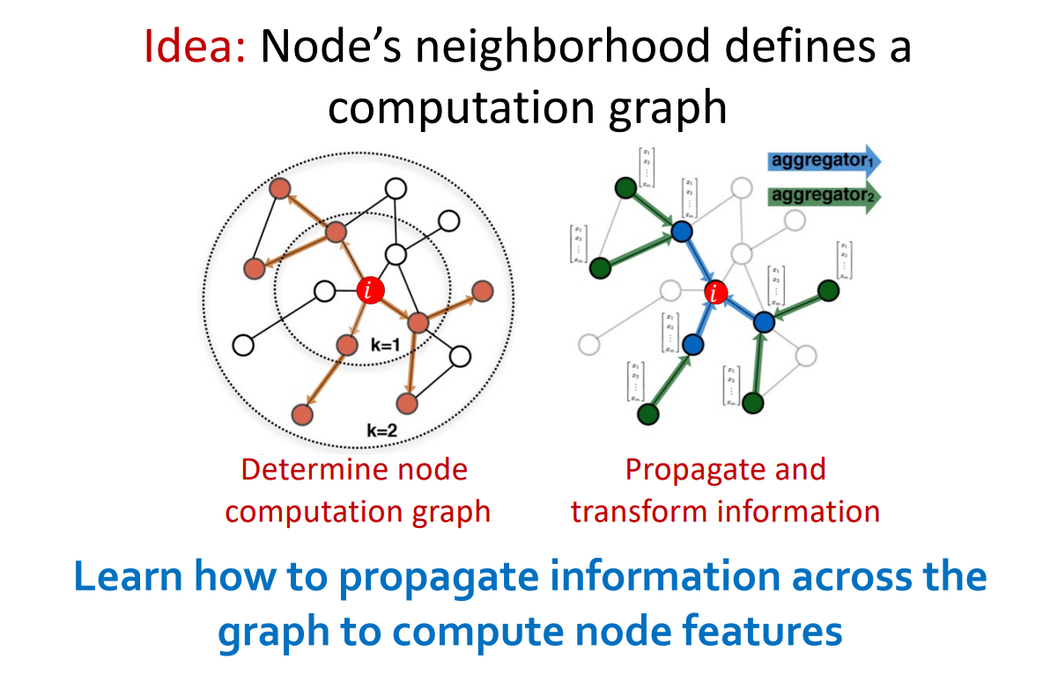
GraphSage

Slide 4
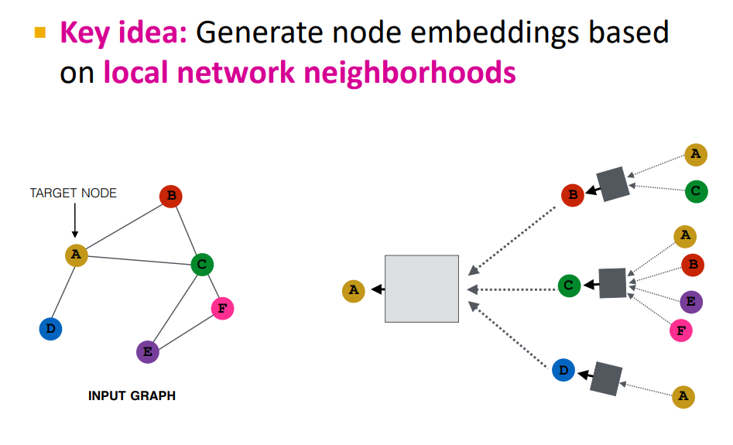
GraphSage

Slide 5
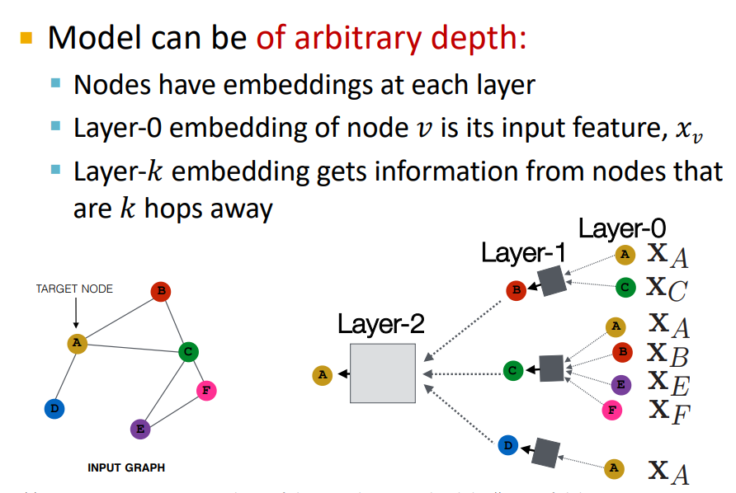

GraphSage

Slide 6
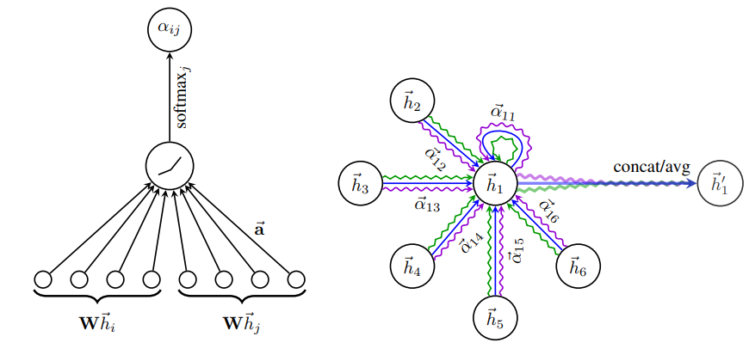


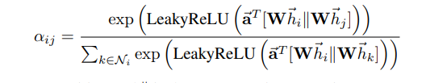
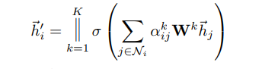
GAT

Slide 7
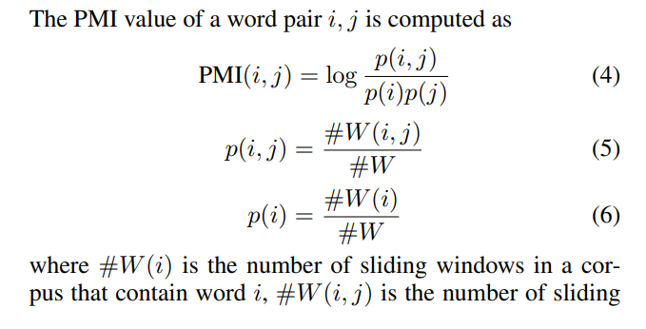

Graph Convolutional Networks for Text Classification
Build a single text graph for a corpus based on word co-occurrence and document word relations, then learn a Text Graph Convolutional Network (Text GCN) for the corpus.
Text GCN is initialized with one-hot representation for word and document, it then jointly learns the embeddings for both words and documents, as supervised by the known class labels for documents.
Utilize global word co-occurrence information using a fixed size sliding window on all documents in the corpus to gather co-occurrence statistics.
Point-wise mutual information (PMI), a popular measure for word associations, to calculate weights between two word nodes.

Slide 8
